Slide 1
Single-Source Shortest Path, All pair Shortest Path
SUBMITTED BY :- ABHISHEK LUTHRA
ROLL NO. – 181210003

Slide 2
SINGLE-SOURCE SHORTEST PATH:-
Single Destination Shortest Path Problem : Find a shortest path from the given destination vertex t to the vertex v. By reversing the direction of each edge in the graph we can reduce each problem to single-source problem.
Single Pair Shortest Path Problem : Find a shortest path from u to v for given vertices u and v. If we solve the single-source problem with source vertex u, we solve this problem also.

Slide 3
DIJKSTRA’S ALGORITHM :-
Dijkstra's algorithm has many variants but the most common one is to find the shortest paths from the source vertex to all other vertices in the graph.

Slide 4
Algorithm Steps:
Set all vertices distances = infinity except for the source vertex, set the source distance = 0.
Push the source vertex in a min-priority queue in the form (distance , vertex), as the comparison in the min-priority queue will be according to vertices distances.
Pop the vertex with the minimum distance from the priority queue (at first the popped vertex = source).
Update the distances of the connected vertices to the popped vertex in case of "current vertex distance + edge weight < next vertex distance", then push the vertex with the new distance to the priority queue.
If the popped vertex is visited before, just continue without using it.
Apply the same algorithm again until the priority queue is empty.

Slide 5
ALGORITHM :-
function dijkstra(G, S)
for each vertex V in G
distance[V] <- infinite
previous[V] <- NULL
If V != S, add V to Priority Queue Q
distance[S] <- 0
while Q IS NOT EMPTY
U <- Extract MIN from Q
for each unvisited neighbour V of U
tempDistance <- distance[U] + edge_weight(U, V)
if tempDistance < distance[V]
distance[V] <- tempDistance
previous[V] <- U
return distance[], previous[]

Slide 6
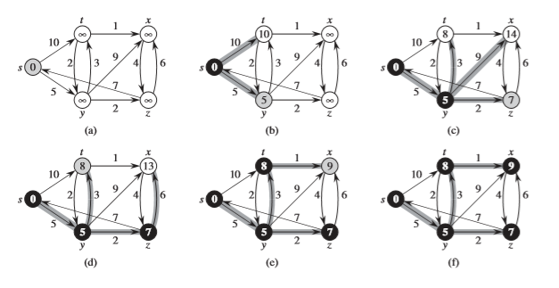
EXAMPLE :-

Slide 7
TIME COMPLEXITY :-
Time Complexity of Dijkstra's Algorithm is O(V2) but with min-priority queue it drops down to O(V+ElogV).

Slide 8
BELLMAN FORD ALGORITHM :-
Bellman Ford's algorithm is used to find the shortest paths from the source vertex to all other vertices in a weighted graph.
It depends on the following concept: Shortest path contains at most n−1 edges, because the shortest path couldn't have a cycle.

Slide 9
Algorithm Steps:
The outer loop traverses from 0 : n−1.
Loop over all edges, check if the next node distance > current node distance + edge weight, in this case update the next node distance to "current node distance + edge weight".

Slide 10
ALGORITHM :-
function bellmanFord(G, S)
for each vertex V in G
distance[V] <- infinite
previous[V] <- NULL
distance[S] <- 0
for each vertex V in G
for each edge (U,V) in G
tempDistance <- distance[U] + edge_weight(U, V)
if tempDistance < distance[V]
distance[V] <- tempDistance
previous[V] <- U
for each edge (U,V) in G
If distance[U] + edge_weight(U, V) < distance[V}
Error: Negative Cycle Exists
return distance[], previous[]

Slide 11
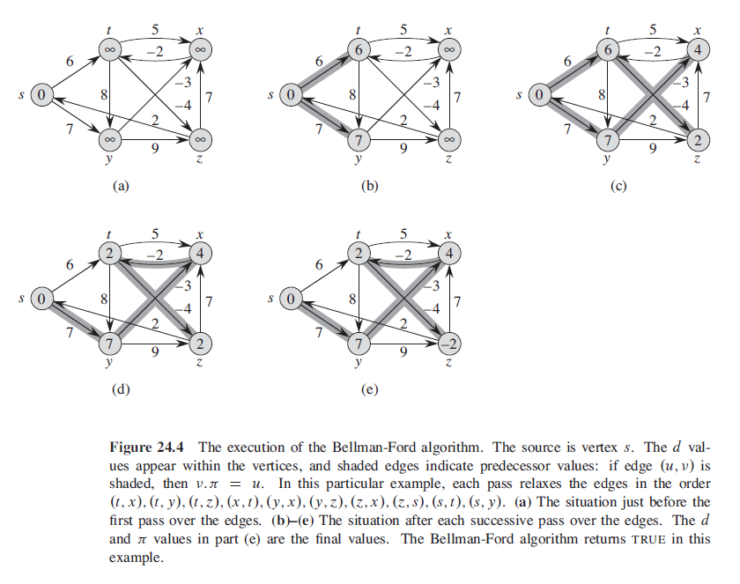
EXAMPLE :-

Slide 12
TIME COMPLEXITY :-
Time Complexity of Bellman Ford algorithm is relatively high O(V⋅E), in case E=V2, O(E3).

Slide 13
ALL PAIR SHORTEST PATH :-
All Pair Shortest Path Problem : Find a shortest path from u to v for every pair of vertices of u and v. Although we can solve this problem by running a single-source algorithm once from each vertex, we usually can solve it faster.
The all pair shortest path algorithm is also known as Floyd-Warshall algorithm is used to find all pair shortest path problem from a given weighted graph.
As a result of this algorithm, it will generate a matrix, which will represent the minimum distance from any node to all other nodes in the graph.

Slide 14
FLOYD-WARSHALL ALGORITHM :-
Floyd–Warshall's Algorithm is used to find the shortest paths between between all pairs of vertices in a graph, where each edge in the graph has a weight which is positive or negative.
The biggest advantage of using this algorithm is that all the shortest distances between any 2 vertices could be calculated in O(V3), where V is the number of vertices in a graph.

Slide 15
The Algorithm Steps:
For a graph with N vertices:
Initialize the shortest paths between any 2 vertices with Infinity.
Find all pair shortest paths that use 0 intermediate vertices, then find the shortest paths that use 1 intermediate vertex and so on.. until using all N vertices as intermediate nodes.
Minimize the shortest paths between any 2 pairs in the previous operation.
For any 2 vertices (i,j) , one should actually minimize the distances between this pair using the first K nodes, so the shortest path will be: min(dist[i][k]+dist[k][j],dist[i][j]).

Slide 16
ALGORITHM :-
n = no of vertices
A = matrix of dimension n*n
for k = 1 to n
for i = 1 to n
for j = 1 to n
A^{k}[i, j] = min (A^{k-1}[i, j], A^{k-1}[i, k] + A^{k-1}[k, j])
return A

Slide 17
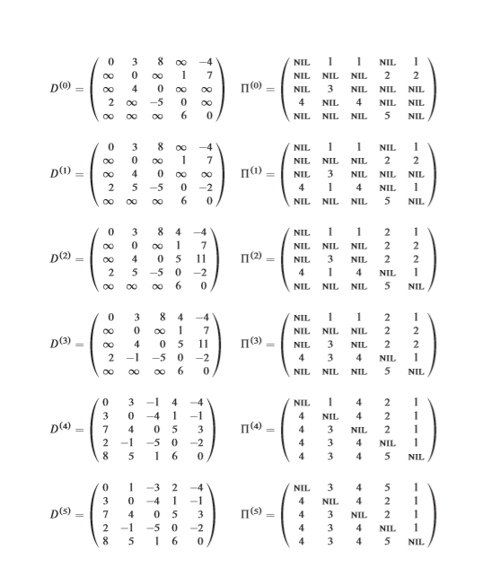
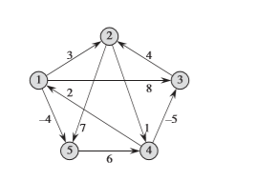
EXAMPLE :-

Slide 18
TIME COMPLEXITY :-
There are three loops. Each loop has constant complexities. So, the time complexity of the Floyd-Warshall algorithm is O(n³).

